Slide 1
Market Basket Analysis with Apriori Algorithm on “Groceries” dataset
Presented By :
Mohini Mahajan
Shubham Patil

Slide 2
Contents
What is market basket analysis?
Objective
Overview:
Apriori algorithm:
The data:
Program flow:
Top 10 most frequent items:
Top 10 rules by “support’’:
Top 10 rules by “confidence”:
Top 10 rules by “lift”:
Discussion:
Conclusion:

Slide 3
What is market basket analysis?
Technique used by large retailers to uncover associates between items.
Combination of items that occurs together frequently in transaction
Technique which identifies the strength of association between pairs of products purchased together and identify patterns of co-occurrence.
Market Basket Analysis creates If-Then scenario rule, for example – if item A is purchased the item B is likely to be purchased.
The rules are probabilistic(i.e. they are derived from the frequencies of co-occurrance in the observations.)

Slide 4
Objective
To find frequently purchased item sets from large transactional Database.
The main objective of Market Basket Analysis is to get better efficiency of market and sales strategy using consumer transactional data collected during the sales transaction.

Slide 5
Overview:
Identifies frequently purchased groceries from given transactional data
Implemented SPSS Modeler A-priori modeling code to calculate support, confidence and lift for association rules
List to 10 frequent bought items, top 10 combination by support, confidence and lift values.

Slide 6
Apriori algorithm:
Apriori algorithm employs a simple a priori belief as guideline for reducing the association rule search space: all subsets of a frequent item-set must also be frequent
The Support of an item-set or rule measures how frequently it occurs in the data
Support(x)=count(x)/N
A rule’s confidence is a measurement of its predictive power or accuracy. It is define as the support of the item-set containing both X and Y divided by the support of the item-set containing only x
Confidence(x y)=support(x,y)/support(x)
Lift is a measure of how much more likely one item is to be purchased relative to its typical purchase rate, given that you know another item has been purchased
Confidence(x y)= support(x,y)/support(x)

Slide 7
SUPPORT
It is a measure of how frequently the collection of items occur together as a percentage of all transactions.
Fraction of transactions that contain both x and y

Slide 8
CONFIDENCE
Ratio of the number of transactions that include all items in B as well as the number of transactions that include all items in A to the number of transactions that include all items in A.

Slide 9
LIFT RATIO
How much our confidence has increased that B will be purchased given that A was purchased.

Slide 10
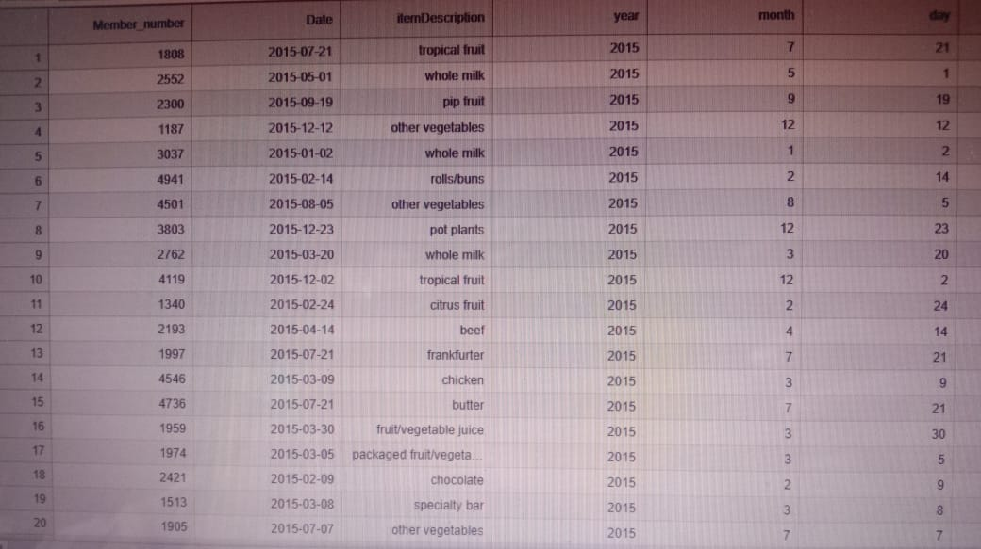
The data:
The dataset has been created by researchers Department of Information System and Operations
The “Groceries” data set contains 1 month (30 days) of real- world point-of-sale transaction data from a typical local grocery outlet. The dataset contains 3898 datasetcontains3898transactions and the items are aggregated to 169 categories
Item categories have been used instead of brands, for simplicity. So “milk” can refer to any brand of milk.

Slide 11
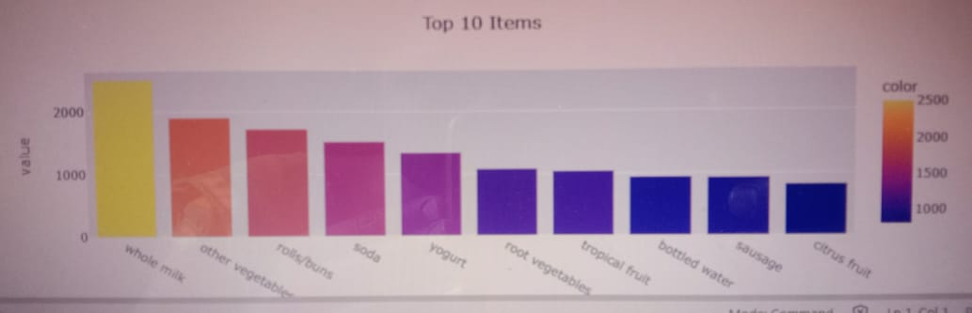
Top 10 most frequent items

Slide 12
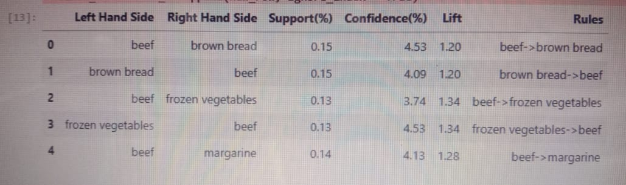
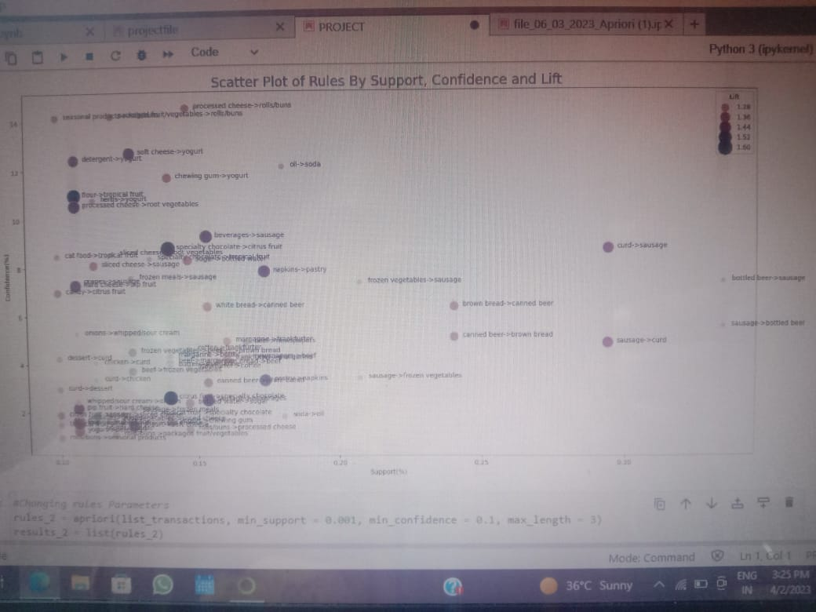
Creating new data frame of rules and Calculating number of rules
Plotting support, confidence and lift of rules

Slide 13
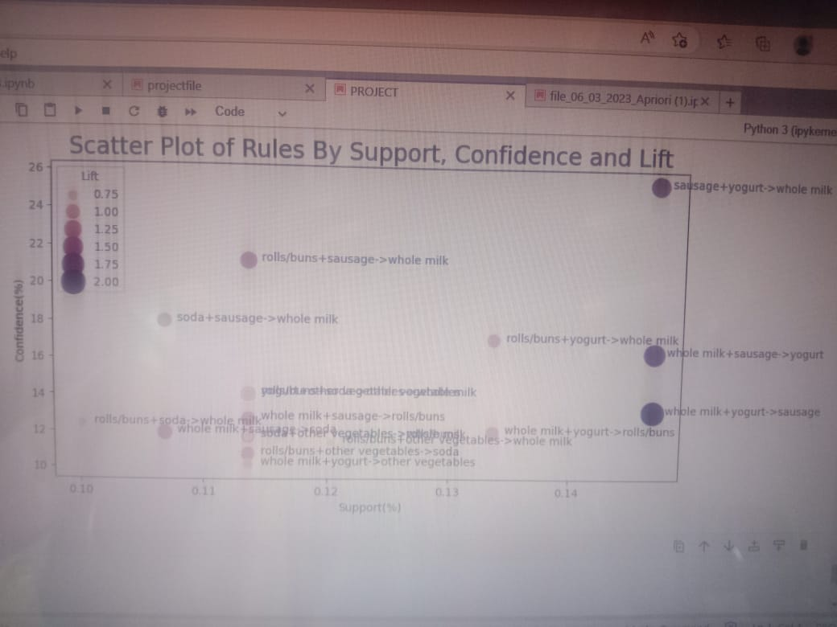
Creating new data frame of new rules and Calculating number of rules
Plotting support, confidence and lift of new rules

Slide 14
Conclusion
The main algorithm used in market basket analysis is the Apriori algorithm. It can be very powerful tool for analyzing the purchasing patterns of consumers. The three statistical measures in market basket analysis are support, confidence. Support measures the frequency an item appears in a given transactional data set, confidence measures the algorithm’s predictive power or accuracy. In our example, we examined the transactional patterns of grocery purchases and discovered both obvious and not-so-obvious patterns in certain transactions.

Slide 15
Thank you

